Slide 2
Mastering Microsoft Graph Connectors with the new Microsoft Graph Python SDK

Slide 4


Gabrielle Williams
Junior at Atholton Highschool
Intern, Addin365
Delta Scholar
gabrielleajwilliams@live.com

Slide 5

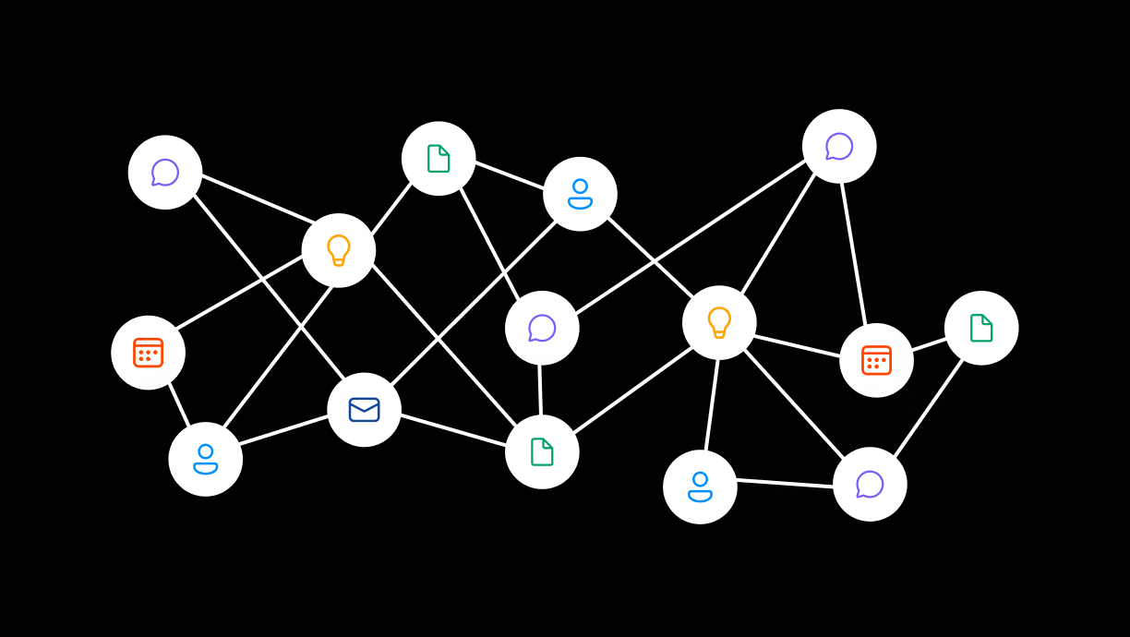



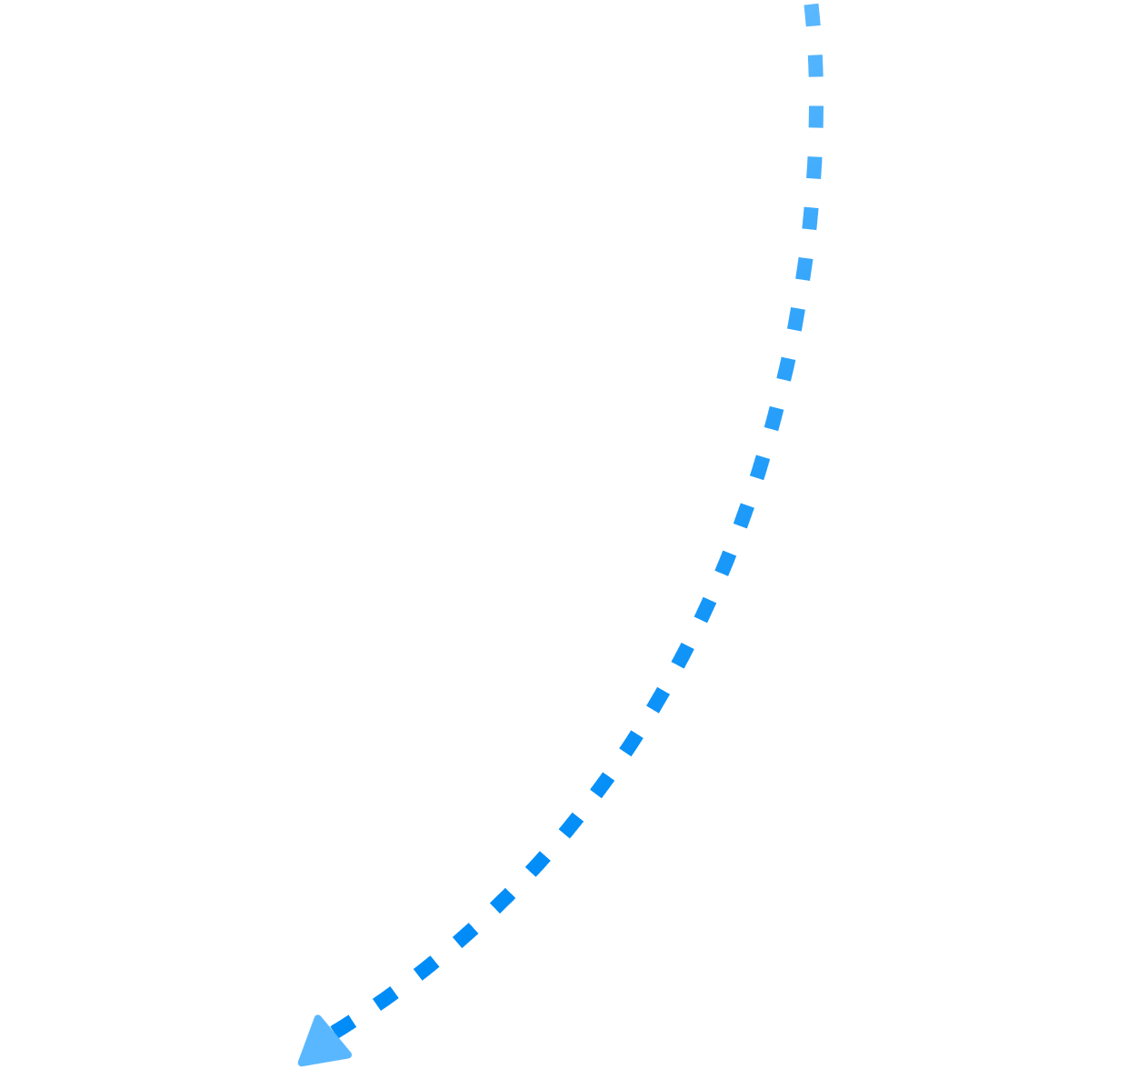














Microsoft Graph
Semantic Fabric leveraged via Microsoft Search
Microsoft Graph embeddings for Microsoft 365 entities
45
20
56
12
90
12
20
35
32
4
72
51
35
83
63
81
77
17
9
32
57
23
82
55
47
57
23
82
55
47
Customers can surface their content as grounding data via Microsoft Graph
Notes:
Let’s briefly talk about a core component of Copilot: the Microsoft 365 Graph.
Microsoft 365 Graph provides a unified programmability model to access the data & intelligence in Microsoft 365
Copilot can access the knowledge in Graph via Microsoft Search, which provides personalized and relevant search results and insights. If you’ve ever searched for an email in Outlook or looked for a file in SharePoint, you’ve used Microsoft Search. Relevancy has been a big challenge for us, which is why we’ve invested in Semantic indexing.
The next session is a deep dive in the Semantic Index, but at a high level: Semantic Fabric is a foundational component of Microsoft Search and the overall Microsoft 365 platform. It enables efficient data indices that support precise entity, passage, and sentence retrieval based on the semantics of content, activity, and relationships rather than keyword matching.
Copilot leverages these three components: Microsoft 365 Graph provides the data, Microsoft Search provides search over this data, and Semantic Fabric enhances the search experience by providing a semantic representation of the data.
Developers can extend the grounding data via graph connectors. Graph connectors allow external content to be stored graph, enabling a way to surface external content in various Microsoft 365 experiences.
To understand how this graph data gets leveraged by Copilot, you have to have an understanding of how prompts work.

Slide 6
Microsoft 365 Copilot has two extensibility points
Microsoft 365 Apps
Plugins • Copilot UX
In-app and cross-app intelligence via Copilot UX
Orchestration
Prompt & response filtering
Metaprompt
Microsoft Responsible AI
Grounding
Microsoft Graph Connectors
Hosted Foundation models
AI infrastructure
Microsoft Azure

Slide 7
Sample scenarios for Copilot for Microsoft 365
Q&A on a single item
Finding a single item
Finding a list of items
Summarization of a single item
Based on this agreement, what’s the penalty if we terminate the office lease early?
Show me the helpdesk ticket that I recently opened about memory leaks
Show me the P1 open work items assigned to my team
Summarize the marketing proposal from Jim

Slide 8

Microsoft Graph Connectors
Existing experiences
New
Search
Microsoft 365 App
M365 Copilot
Combined Index of Your Data and Microsoft 365 Data
Microsoft Graph
External Data Sources

Slide 9
Demo
Admin Experience and Run Through with OOB Connectors
Run Time Copilot Experience & Search with various Hubs

Slide 10

Graph Connector building blocks
Connection
Use Microsoft Graph API to create connection and to ingest external items and activities.
Schema
A JSON definition of metadata properties along with aliases, semantic labels, etc.
Permissions
Allow or deny list of users, groups, or everyone (in tenant) to define access to items. Applies to all experiences.
Notes:
Order should be Schema, Permissions, API
Data flow + if you want to build (and who can build, how long it takes)
Add SDK
Common pitfalls: getting permissions right (especially e.g. Salesforce)

Slide 11


Graph connector architecture – sync approaches
Sync delta on scheduled basis
(daily, hourly, every X mins)
Scheduled
(pull model)
Trigger / webhook pushes content as event happens
Event-based
(push model)

Slide 12

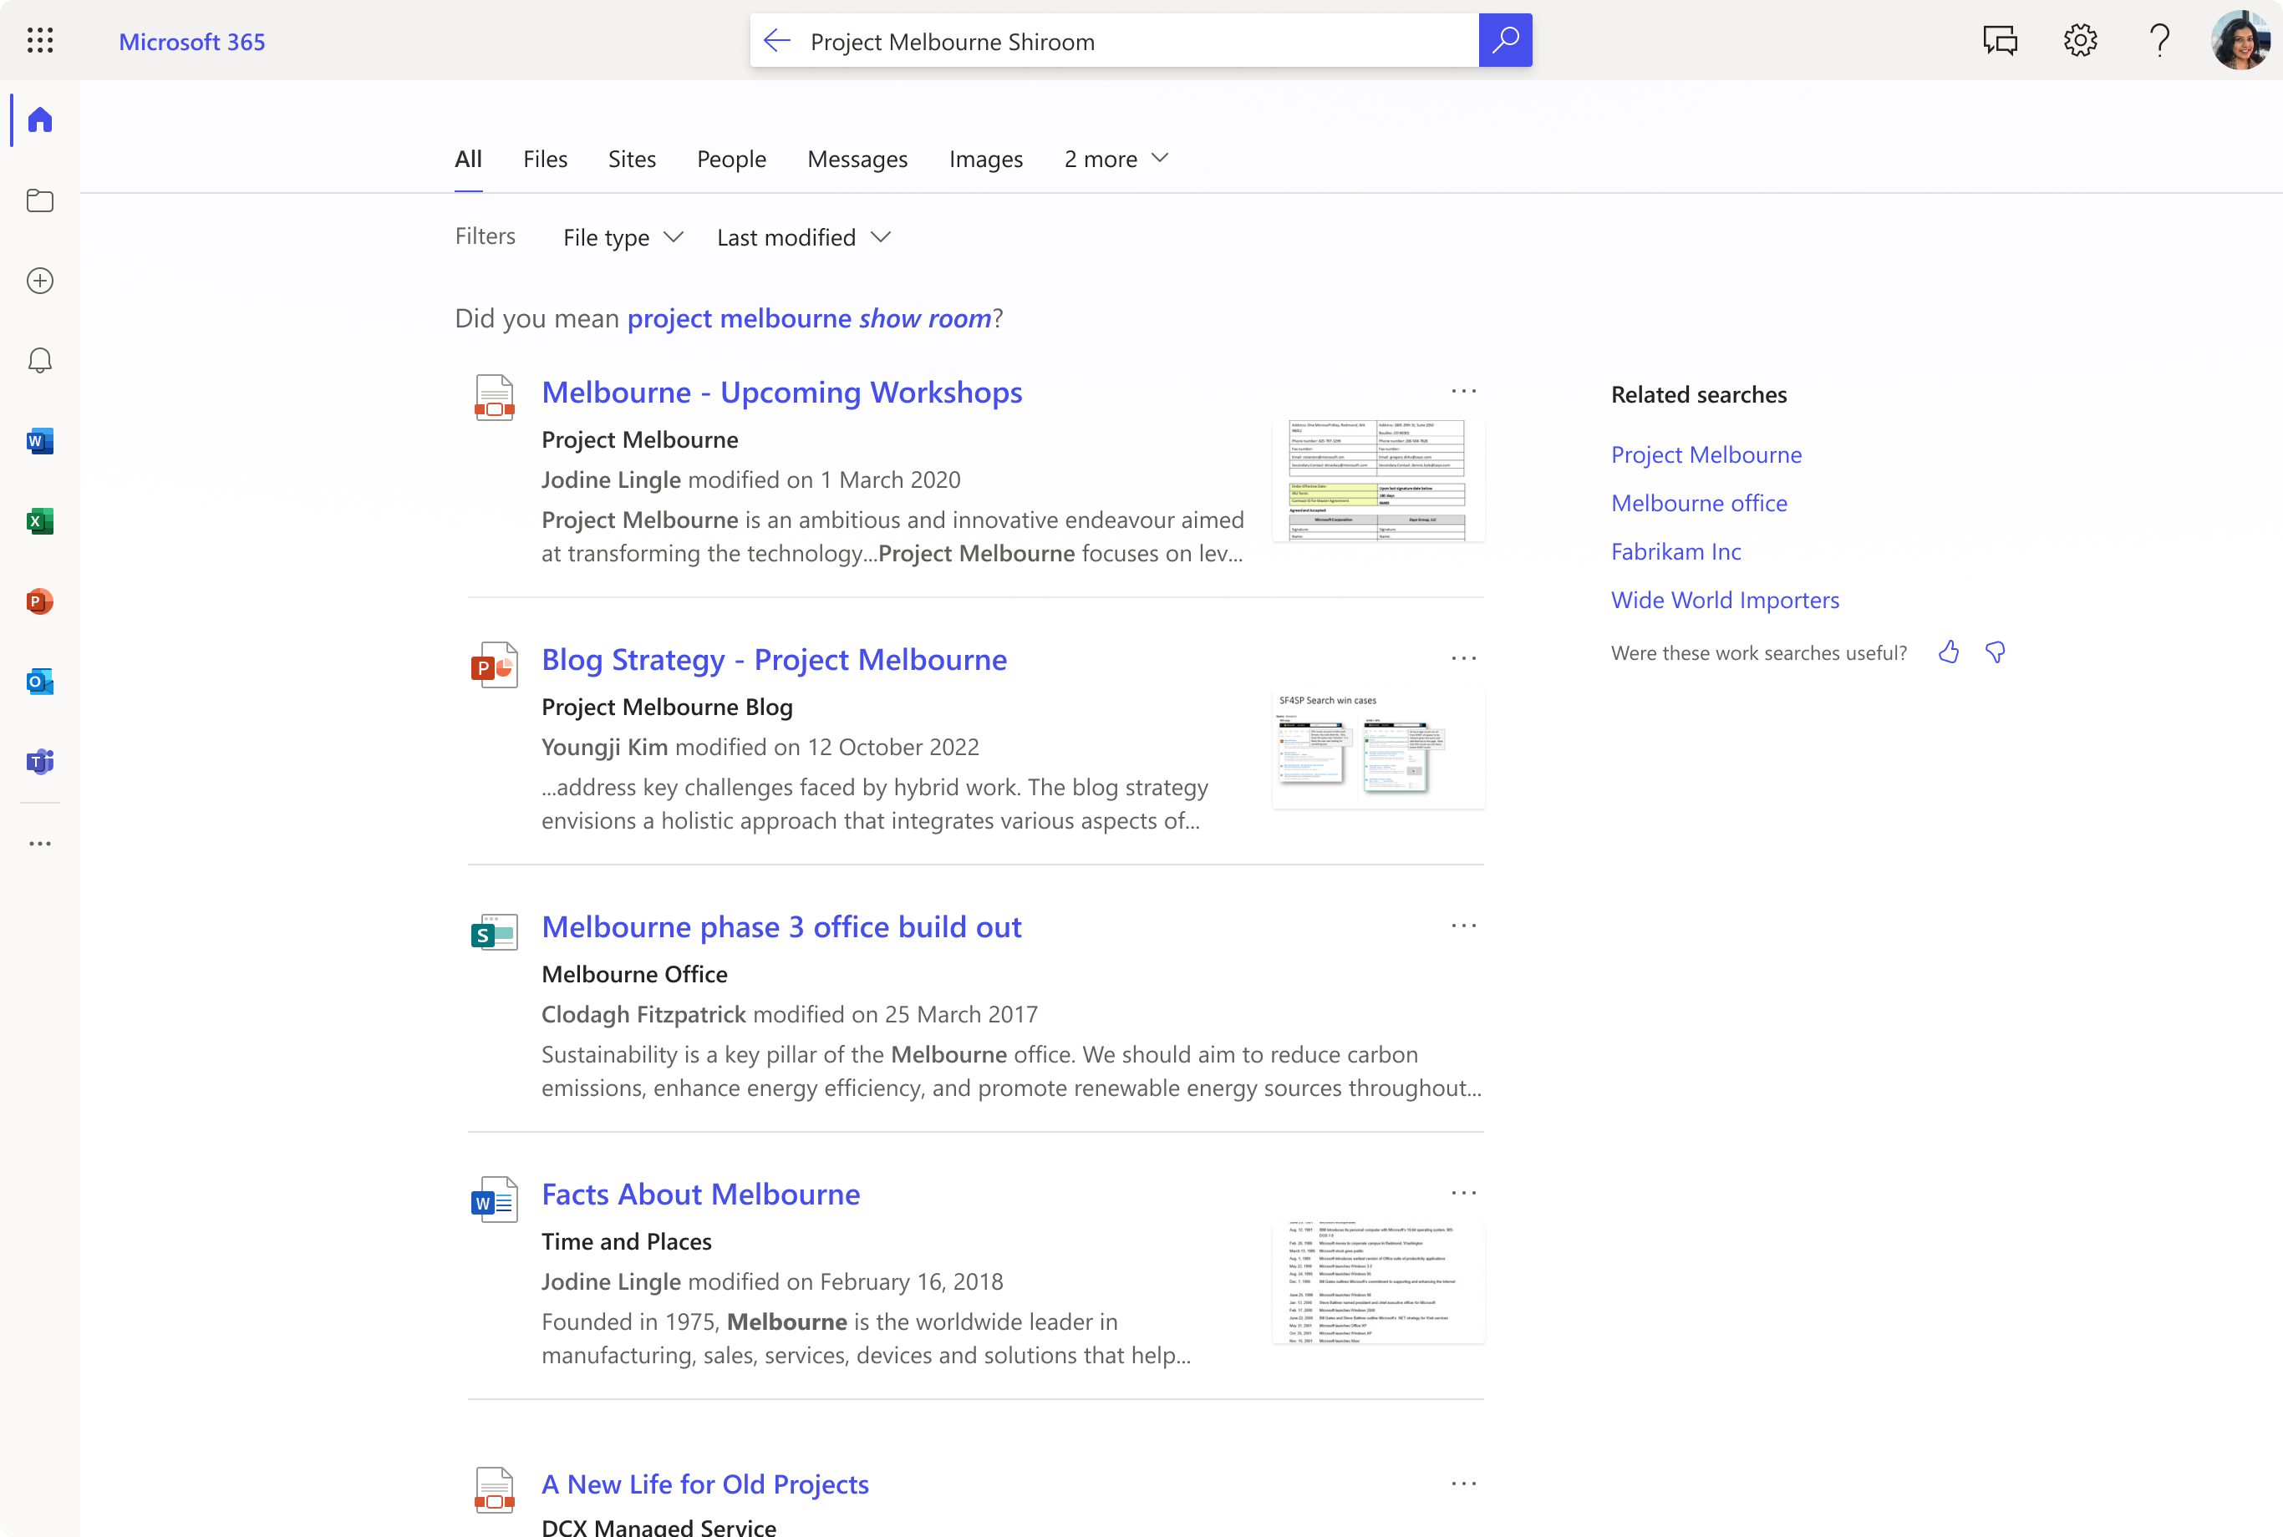
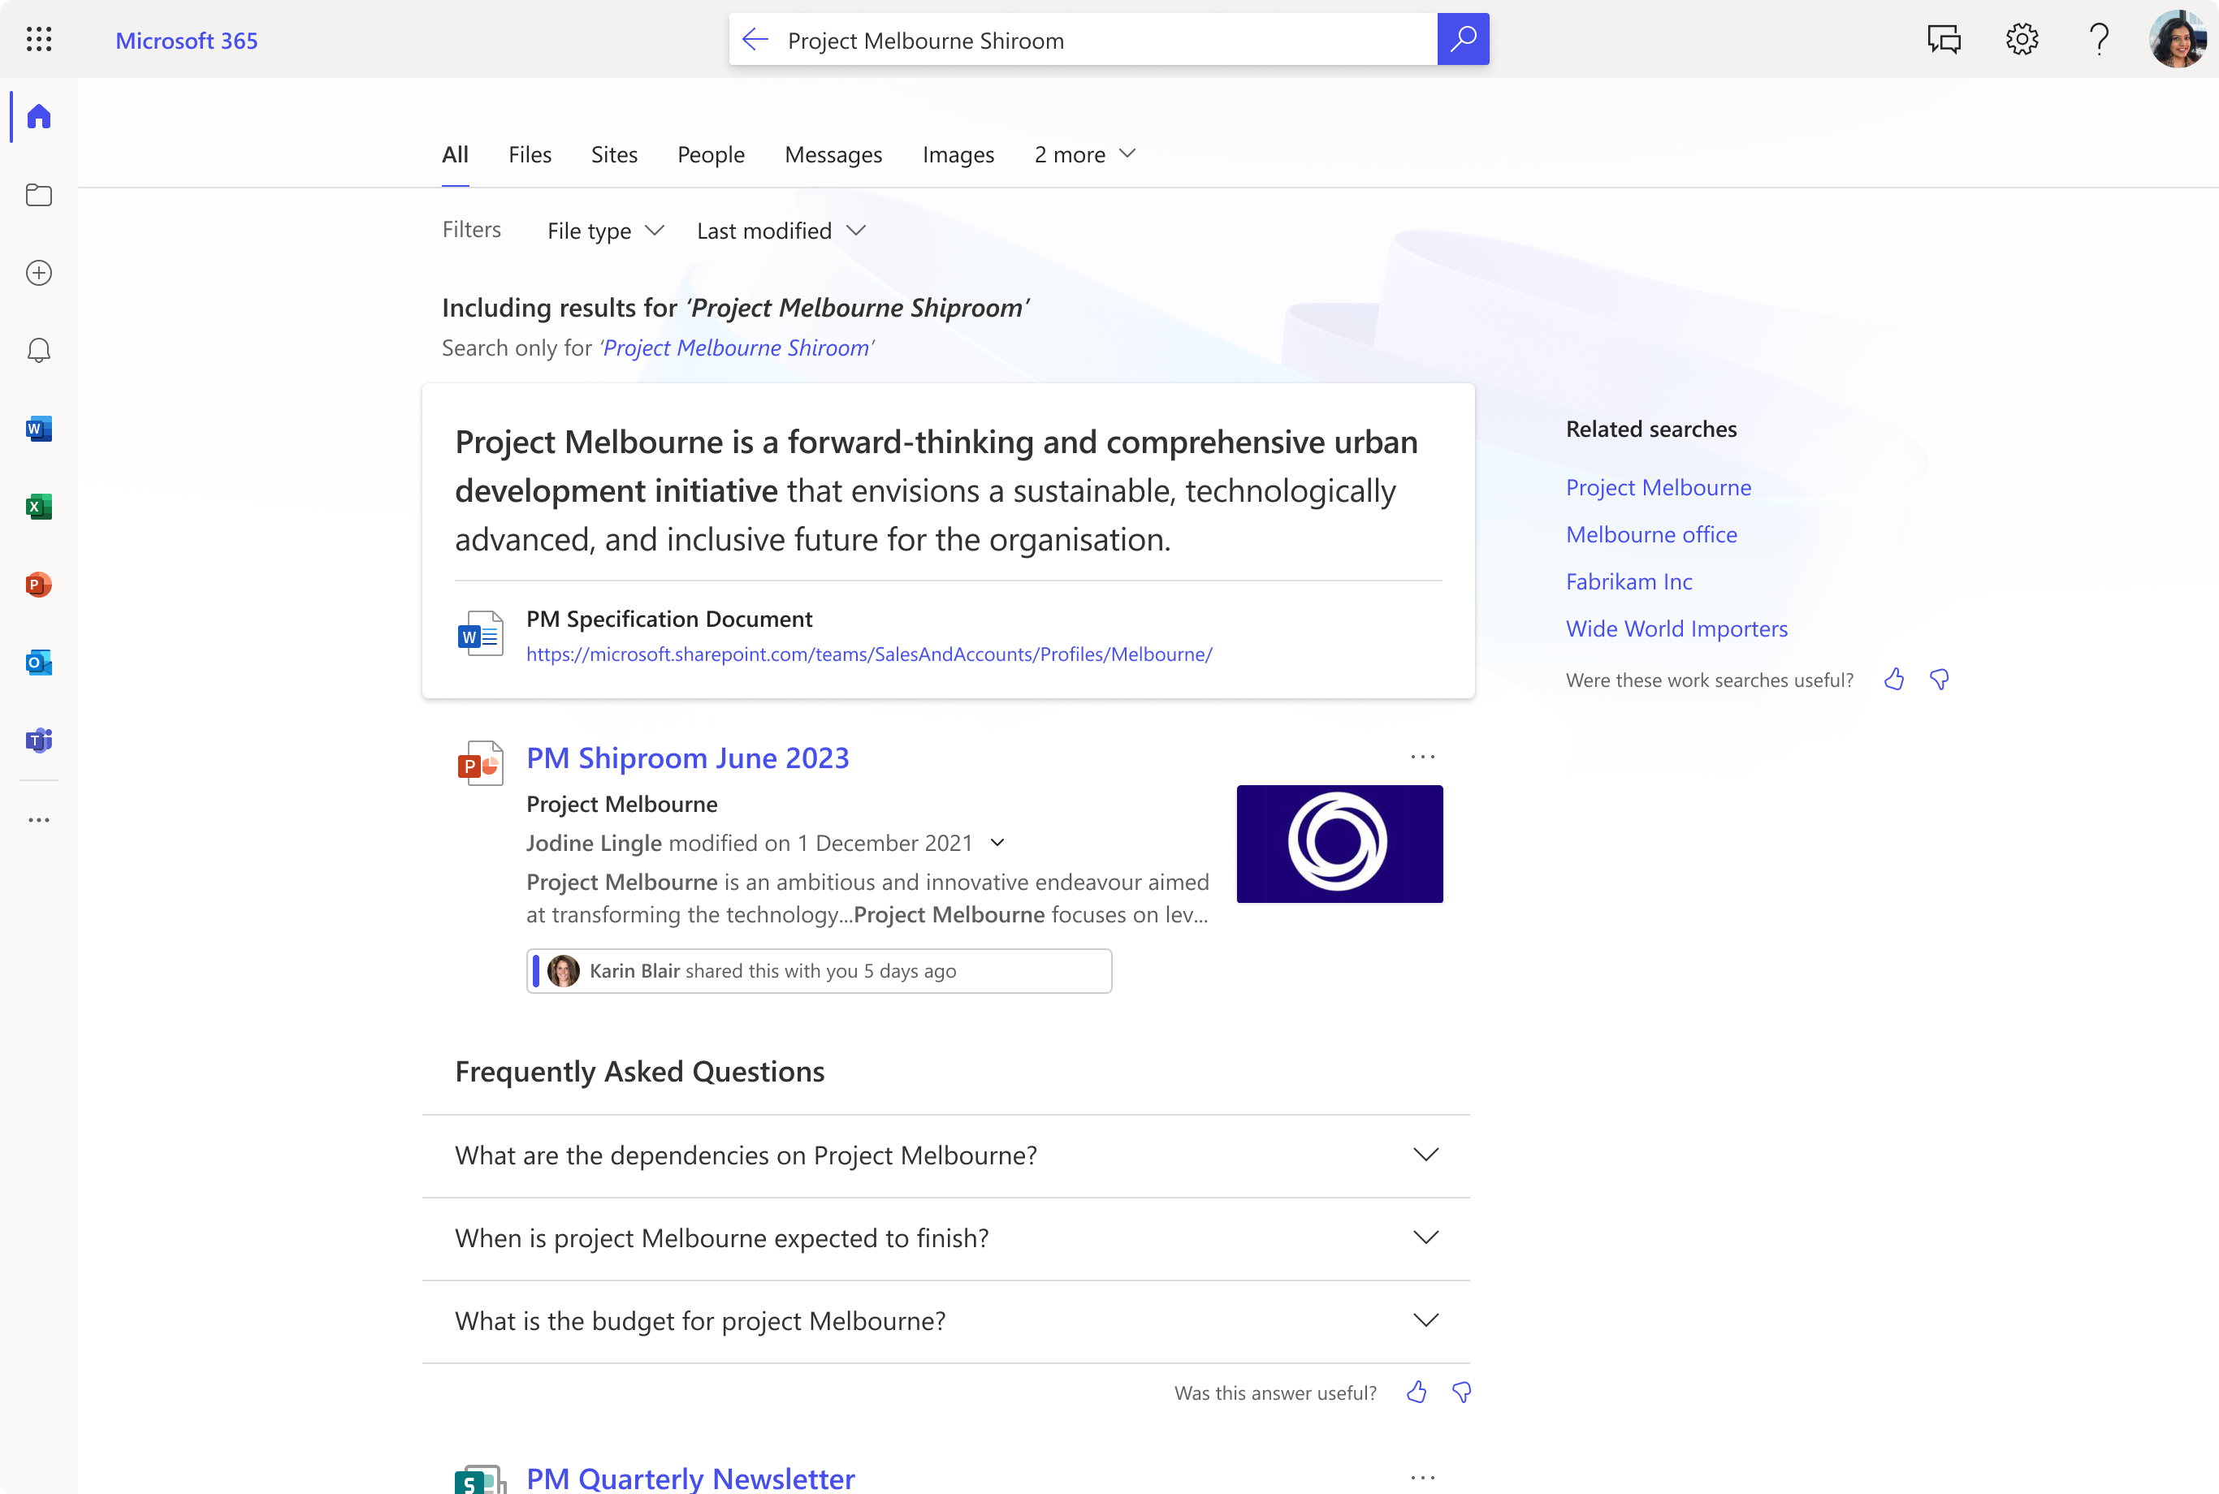
Combined Index of Your Data + Microsoft 365 Data for Copilot = Improved Search
keyword matched results & suggestions
autocorrected spelling of organizational jargon
informative answers directly from content
closest matched content ranked in order
more relevant results, based on search intent
last modified date and person adds relevance
enhanced content sharing insights
document summary provides context
AI generated questions and answers on topic
Without a Combined Index of Your Data and Microsoft 365 Data for Copilot
With a Combined Index of Your Data and Microsoft 365 Data Semantic Index for Copilot
Notes:
Here’s an example of the differences between a standard search from Microsoft 365 and what is available with the Semantic Index for Copilot and with Microsoft 365 Copilot enabled. The user has misspelled a request to find information on ‘Project Melbourne’
Semantic Index for Copilot will be able to understand the intent behind your prompts and commands, producing more relevant, transparent results. It sets the foundation for interacting with large language models in a trusted, personalized way and helps users move one step closer to overcoming challenges finding answers in overwhelming amounts of data in their organization. Understanding why you see something is also as important as getting the right search result itself, and search will now show you why you see a result, such as your relationship to a document, person, and more.

Slide 13
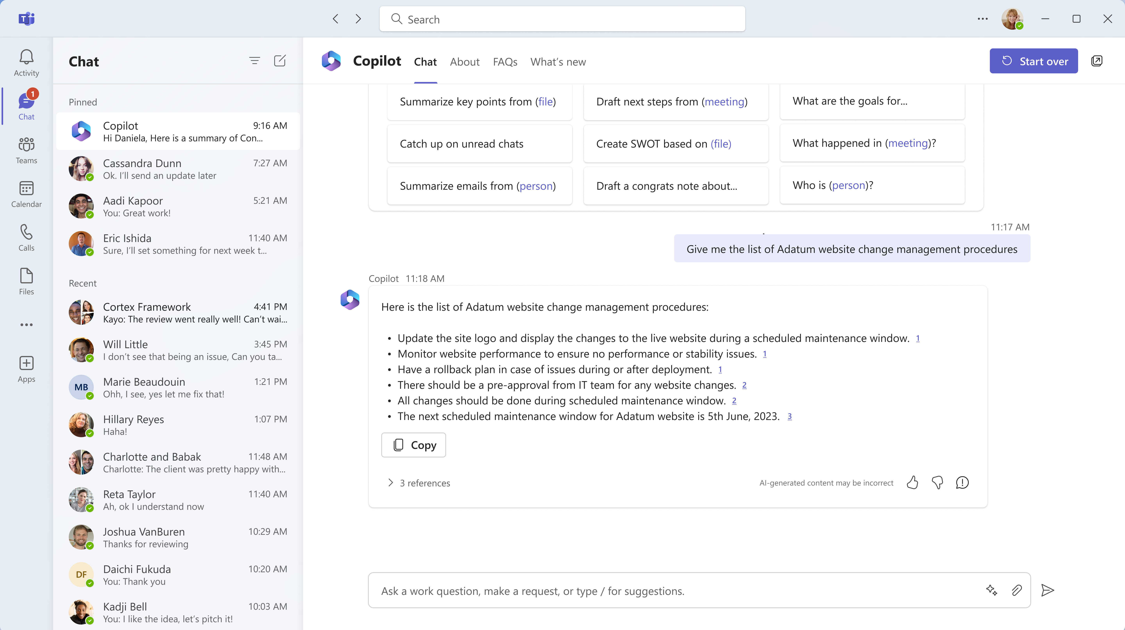
Summarize content in a meaningful way
Insert Image or media Here
Notes:
How does it look with M635 data only vs with Connected content (@mike to share what he’s been using)

Slide 14
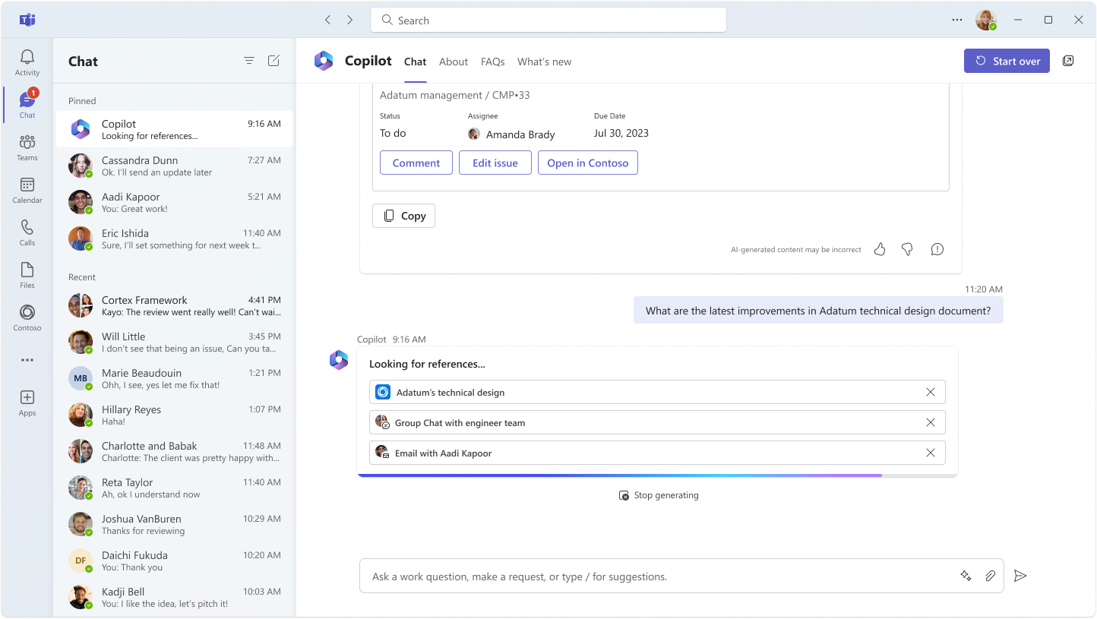
Combined Index-powered content analysis
Insert Image or media Here
Notes:
Powered by Semantic Index, Copilot analyses your Graph data to map content relations

Slide 15
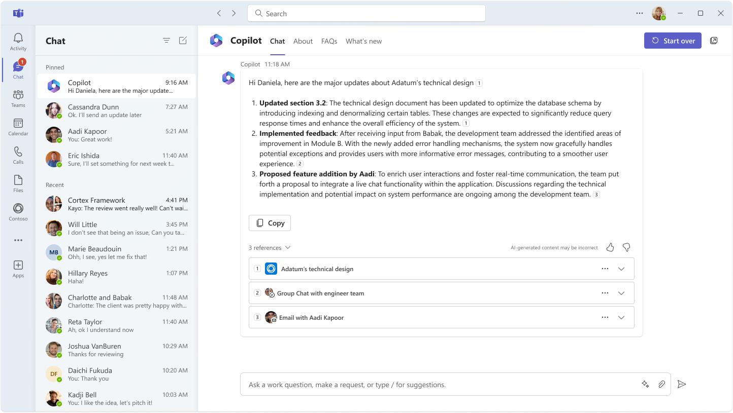
Access citations to find summarized resources
Insert Image or media Here
Notes:
Access citations, enabling users to find summarized resources
We need to confirm the actual experience. For example, are we currently able/near term able to list, bullet, bold, etc.

Slide 16
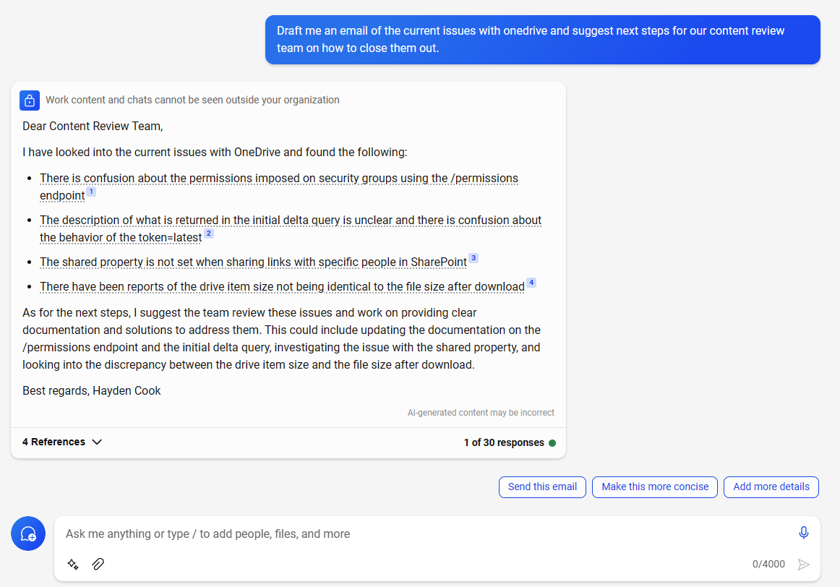
Notes:
Demo 2

Slide 17


twitter handle
BLOG URL

